Slide 1
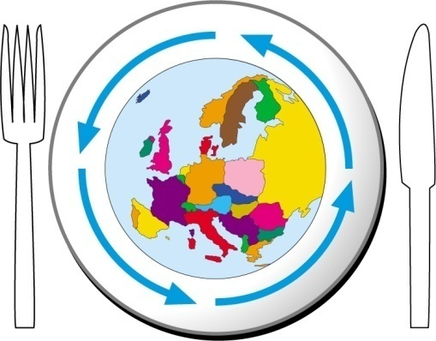
Introduction: Maurizio Mariani

Slide 2
New skills for transitioning to sustainable food systems
This year, the campus will focus on green competences and new skills needed for transitioning to food systems that are more sustainable from an environmental, social, economic and cultural point of view, in line with the objectives set by the Sustainable Development Goals of the United Nations and the European Green Deal.
Building on the GreenComp framework, published by the Joint Research Centre of the European Commission in 2022, we will explore which knowledge, skills and attitudes are most needed in a changing world.….
.

Slide 3
New skills for transitioning to sustainable food systems
Developing competences around sustainability addresses the problem of labour mismatch, which comes from the difficulty of finding skilled workers capable of tackling issues that are becoming more and more relevant.
But becoming competent around sustainability is not only an asset that responds to the needs of the market:
it also addresses the deep need to contribute something in the journey toward a better future, to feel that our work makes a difference, a need that is growing, especially among the youngest of us.
.

Slide 4
New skills for transitioning to sustainable food systems
Sustainability as a competence goes beyond acquiring a set of skills and expanding your knowledge: it becomes a real tool to empower learners to take action, overcoming the cognitive dissonance that comes from knowing about an issue but lacking the agency to act.
It is grounded in transformative learning, as it aims to change the
perspective of learners and their personal view on the world through a holistic approach and profound personal engagement.
This process validates different sources of knowledge, calling into question emotional and
relational intelligence, as well as rational thinking.
.

Slide 5
New skills for transitioning to sustainable food systems
This need for new skills also allows for the emergence of new professional profiles, combining relational competences with knowledge and skills around sustainability.
This is the case of the “city food maker”, a figure that can be found in several cities that have achieved outstanding results in the improvement of the sustainability of their food system.
The city food maker, who plays a crucial role in fostering change, is that person that is capable of “connecting the food dots”, ensuring communication among all stakeholders of a city's food
system.
.

Slide 6
THE AGENDA

Slide 8
SUMMER CAMPUS RULES .
DURING YOUR STAY
Matteo Basei will ask tou to make some picture and short video interviews during the free time at the campus to be posted on our social media channel or to be post on our website
Timing:
Breakfast is at 08h00 end 09h00
Lunch is at 12h30
Diner is at 20h00
At the restaurant
Coffe breaks are at 10h30-11h00 and 15h30-16h00
On the Patio
Please be punctual !

Slide 9
SUMMER CAMPUS RULES .
DURING YOUR STAY
During all sessions, please switch your phone to silent mode. Of course, you can still take pictures and post messages on social media.
La Bergerie is a fenced property, if you go out after dinner, outside the property, you must have the code (1629) to open the pedestrian gate.
During meals or coffee breaks, if you decide to go outside, please return your glasses and tableware to their place.
Before to leave the restaurant pls get your tableware and place on the trolley.
The Wi-Fi:
ID: BERGER22 - PW:INTERNET

Slide 10
SUMMER CAMPUS RULES
BEFORE TO LEAVE THE CAMPUS:
Before leaving:
Please strip the bed, remove the pillowcase, and put the sheets in the provided bag.
For each room/apartment:
1 Bedding bag
1 Bag for towels
Remove waste from bathroom and from the room and place on the bag following the instruction for waste separate collection.
Please leave your rooms as tidy and clean as possible.
Do not forget any personal belonging into the room.

Slide 11
Thanks
Maurizio Mariani
CEO Eating City Platform
m.mariani@eatingcity.org

